Slide 1


Name of Project
Spam Email Detection using Machine Learning
Group Members :
1. Bhushan Ahire
2. Nandini Chavan
3. Girish Chaudhari
4. Hiral Dhangar
5. Ankita kahandal

Slide 2

Introduction/Motivation
Email is one of the most widely used forms of digital communication.
But many emails are spam (junk) or phishing (trying to trick people).
Spam emails waste time, storage, and bandwidth.
It can also cause big problems like fraud, stealing personal info, or spreading viruses.
Old rule-based filters (fixed rules) can’t catch new and smart spam tricks.
Using Machine Learning (ML) makes spam detection smarter, faster, and more reliable.

Slide 3
Problem Statement
Spam wastes storage, data, and time, and it is risky for security.
Old filtering methods are weak against new spam techniques.
We need a strong ML-based solution to solve this problem.

Slide 4
Objectives
To analyze email datasets and extract relevant features.
To implement classification models (Naive Bayes, SVM, Random Forest).
To evaluate performance using accuracy, precision, recall, and F1-score.
To recommend the best model for spam detection.

Slide 5
Literature Review / Existing Solutions
Traditional rule-based systems (keyword filters).
Machine learning approaches (Naive Bayes, Decision Trees, SVM).
Recent advancements using deep learning models (RNNs, LSTMs).
Existing datasets like SpamAssassin, Enron, and UCI ML repository.

Slide 6
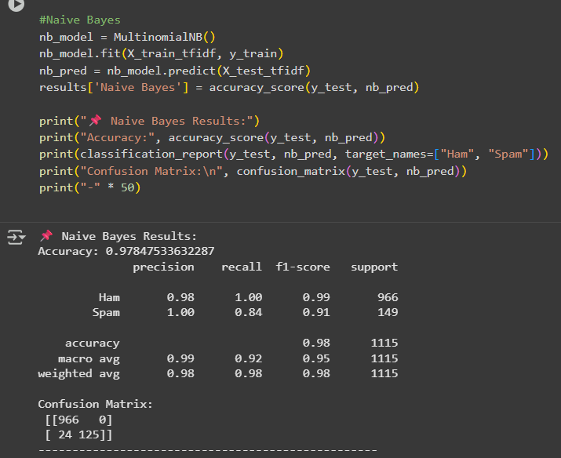
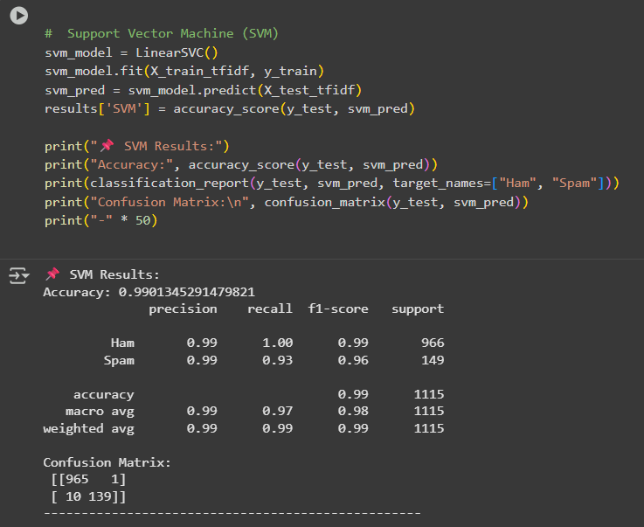
Proposed Solution
Build a machine learning–based spam detection system.
Apply preprocessing techniques to clean and normalize email text.
Extract features using TF-IDF and Bag-of-Words representations.
Train and test multiple classifiers: Naive Bayes, SVM, and Random Forest.

Slide 7
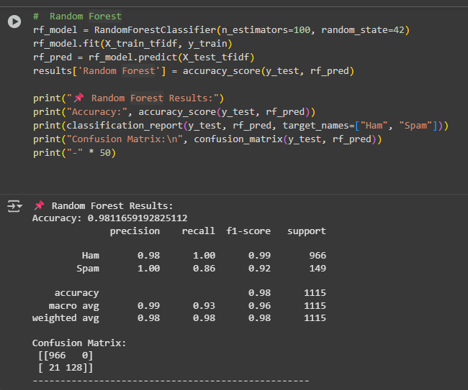
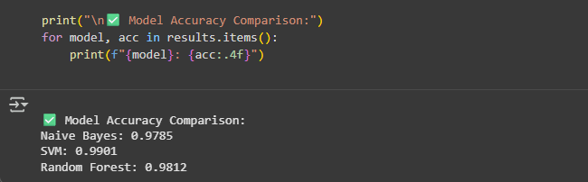
Compare models based on accuracy, precision, recall, and F1-score.
Recommend the optimal model for real-world spam email detection.

Slide 8
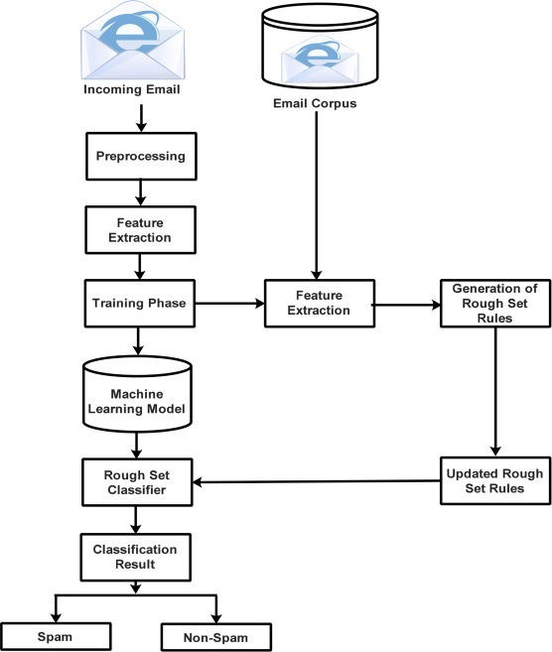





System Architecture
Email Ingestion
Raw email input processing
Preprocessing
Tokenisation, stop word removal, lemmatisation
Feature Extraction
TF-IDF vectorisation
Classification
ML model prediction
Output
Spam/Ham classification

Slide 9
Dataset/Tools
Dataset: SpamAssassin, UCI Spam dataset
Tools: Python, Scikit-learn, NLTK, Pandas, NumPy, Matplotlib
Environment: Jupyter Notebook/Google Colab

Slide 10
Methodology / Model Building / Implementation
Load and preprocess dataset
Text preprocessing (lowercasing, stopword removal, stemming)
Feature engineering (TF-IDF, Bag-of-Words)
Model training (Naive Bayes, SVM, Random Forest)
Model evaluation (accuracy, precision, recall, F1-score)
Compare results

Slide 11
Results & Analysis
Naive Bayes: High precision, good baseline model
SVM: Better accuracy and recall, handles high-dimensional data well
Random Forest: Balanced performance, good interpretability
Best performing model depends on evaluation metric (likely SVM)
Github Repositories :
https://github.com/Bhush8766/Shell-Training-Edunet-
https://github.com/chavannandini28/Shell-Training-Edunet-

Slide 12
Social Impact/ Future Scope & Conclusion
Social Impact:
Reduces spam threats, enhances productivity, improves cybersecurity.
Future Scope:
Incorporate deep learning (RNN, Transformer-based models), deploy real-time spam filters, integrate with email providers.
Conclusion:
ML-based spam detection significantly improves classification accuracy compared to rule-based systems.

Slide 13
Thank You😊

